Slide 1

Divide and Conquer

Slide 2
Divide-and-Conquer
A problem is divided into several (often 2) sub-problems of same type, ideally of about equal size.
The sub-problems are solved (often recursively).
Combine solutions to sub-problems into solution to overall problem.
Notes:
Most famous approach to problem solving

Slide 3
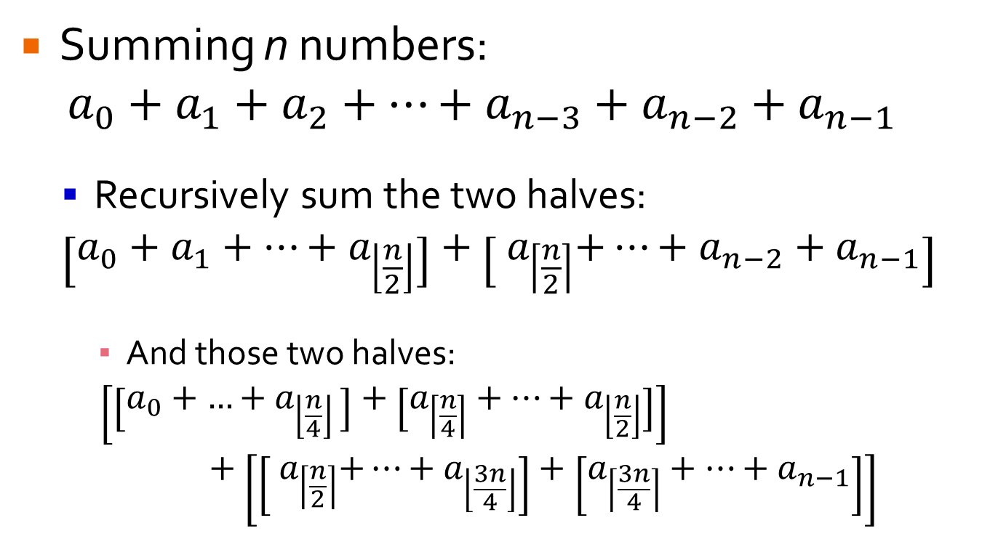
Simple Example
Summing n numbers:
$$a_{0}+a_{1}+a_{2}+…+a_{n−3}+a_{n−2}+a_{n−1}$$
Recursively sum the two halves:
$$\left[a_{0}+a_{1}+…+a_{\left\lfloor \frac{n}{2}\right\rfloor }\right]+\left[{ a}_{\left\lceil \frac{n}{2}\right\rceil }+…+a_{n−2}+a_{n−1}\right]$$
And those two halves:
$$\left[\left[a_{0}+{…+a}_{\left\lfloor \frac{n}{4}\right\rfloor }\right]+\left[a_{\left\lceil \frac{n}{4}\right\rceil }+…+a_{\left\lfloor \frac{n}{2}\right\rfloor }\right]\right]+\left[\left[{ a}_{\left\lceil \frac{n}{2}\right\rceil }+…+a_{\left\lfloor \frac{3n}{4}\right\rfloor }\right]+\left[a_{\left\lceil \frac{3n}{4}\right\rceil }+…+a_{n−1}\right]\right]$$

Slide 4
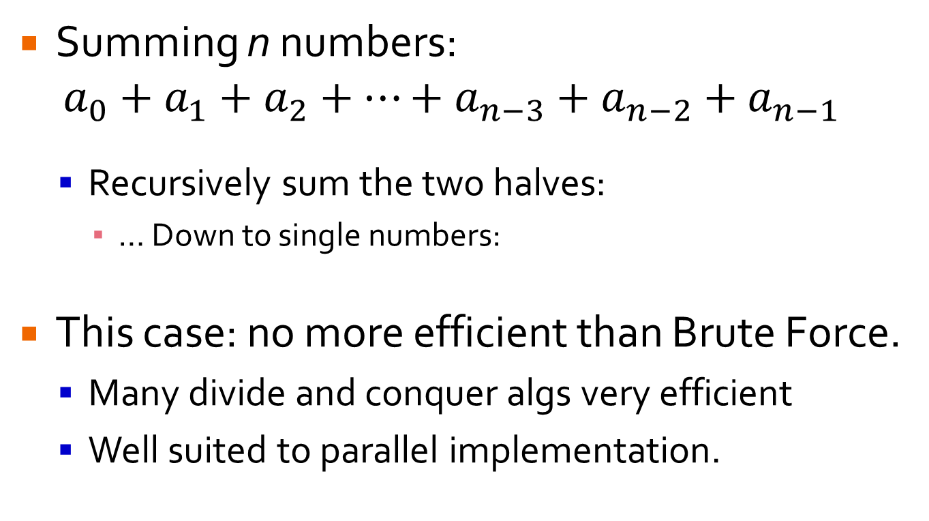
Simple Example
Summing n numbers:
$$a_{0}+a_{1}+a_{2}+…+a_{n−3}+a_{n−2}+a_{n−1}$$
Recursively sum the two halves:
… Down to single numbers:
This case: no more efficient than Brute Force.
Many divide and conquer algs very efficient
Well suited to parallel implementation.

Slide 5
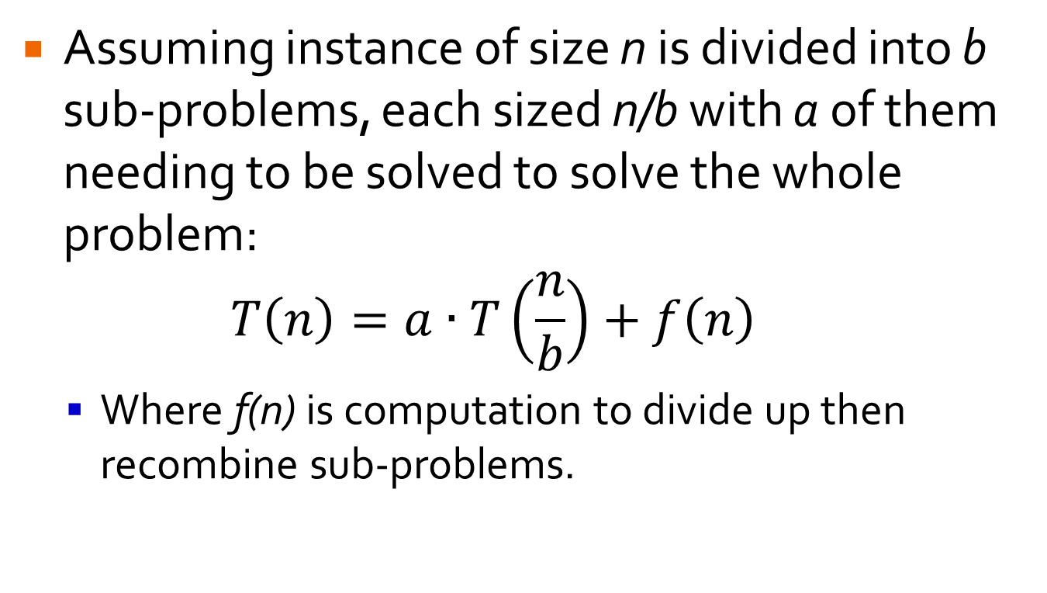
Efficiency of Divide and Conquer
Assuming instance of size n is divided into b sub-problems, each sized n/b with a of them needing to be solved to solve the whole problem: $T\left(n\right)=a∙T\left(\frac{n}{b}\right)+f\left(n\right)$
Where f(n) is computation to divide up then recombine sub-problems.

Slide 6
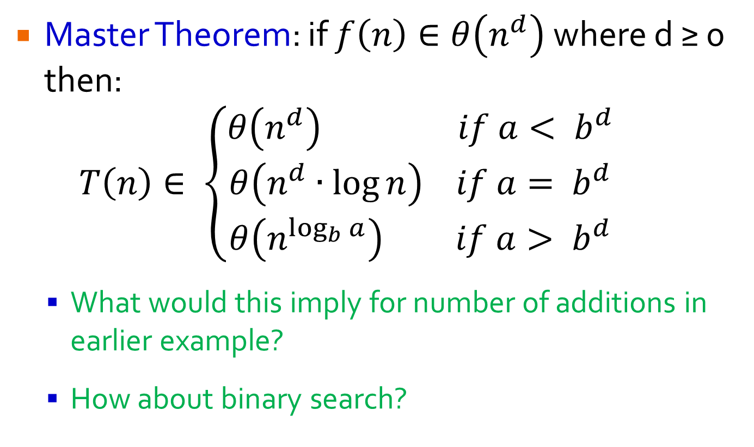
Efficiency of Divide and Conquer
Master Theorem: if $f\left(n\right)∈θ\left(n^{d}\right)$where d ≥ 0 then: $T\left(n\right)∈ \left\{\begin{matrix}θ\left(n^{d}\right) if a< b^{d} \\ θ\left(n^{d}∙\log{n}\right) if a= b^{d} \\ θ\left(n^{\log_{b}{a}}\right) if a> b^{d}\end{matrix}\right.$
What would this imply for number of additions in earlier example?
How about binary search?

Slide 7
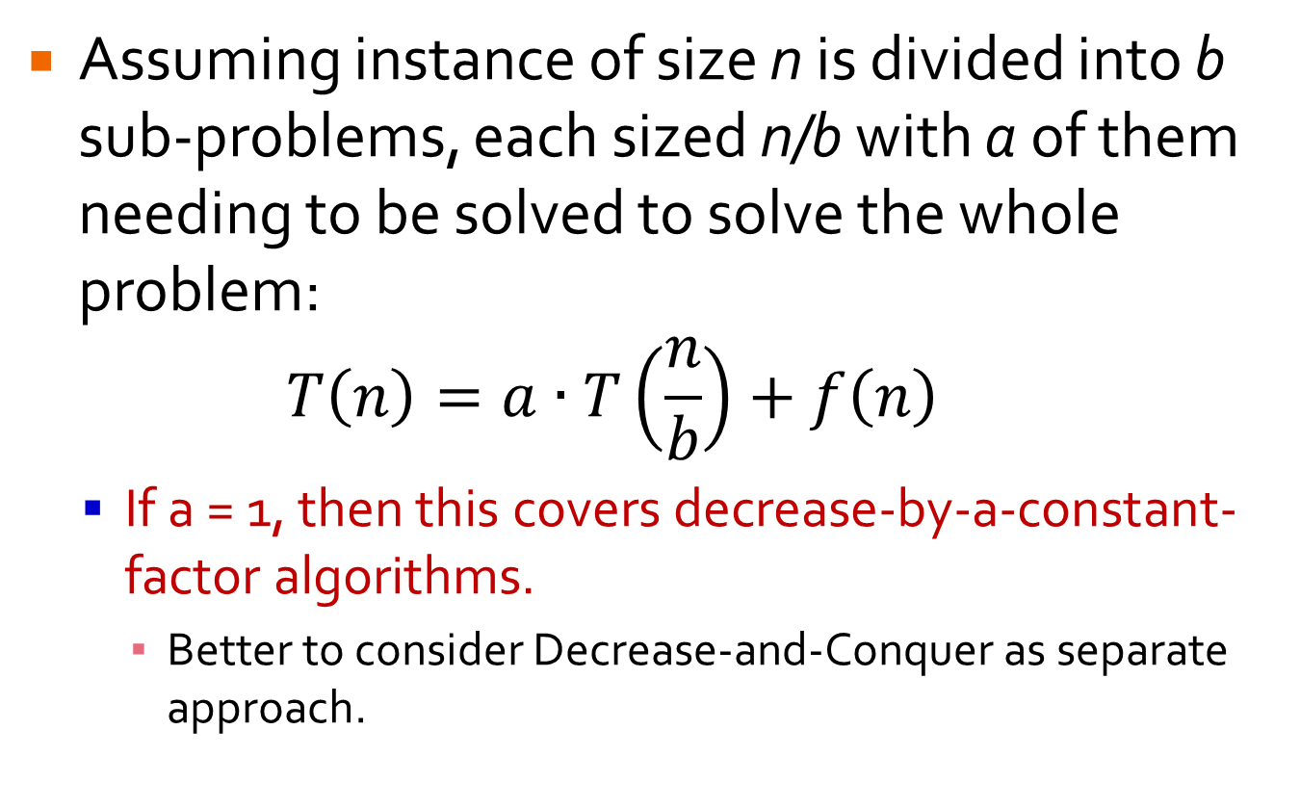
Efficiency of Divide and Conquer
Assuming instance of size n is divided into b sub-problems, each sized n/b with a of them needing to be solved to solve the whole problem: $T\left(n\right)=a∙T\left(\frac{n}{b}\right)+f\left(n\right)$
If a = 1, then this covers decrease-by-a-constant-factor algorithms.
Better to consider Decrease-and-Conquer as separate approach.

Slide 8
Divide and Conquer Sorting

Slide 9
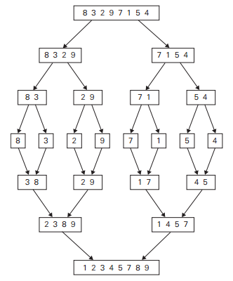
Mergesort
Recursively divide array in half.
Stop at single element.
Merge sorted halves back into sorted array.

Slide 10
Mergesort
Mergesort(A[0…n-1])
if n > 1
copy A[0…^{n}/₂-1] to B[0…^{n}/₂-1]
copy A[^{n}/₂…n-1] to C[0…^{n}/₂-1]
Mergesort(B[0…^{n}/₂-1])
Mergesort(C[0…^{n}/₂-1])
Merge(B,C,A)
Merge(B[0…p-1],C[0…q-1],A[0…n-1])
i ← 0; j ← 0; k ← 0;
while i < p and j < q do
if B[i] ≤ C[j]
A[k] ← B[i];
i ← i+1;
else
A[k] ← B[j];
j ← j+1;
k ← k+1;
if i = p
copy C[j…q-1] to A[k…n-1]
else
copy B[i…p-1] to A[k…n-1]
8 | 3 | 2 | 9 | 7 | 1 | 5 | 4

Slide 11
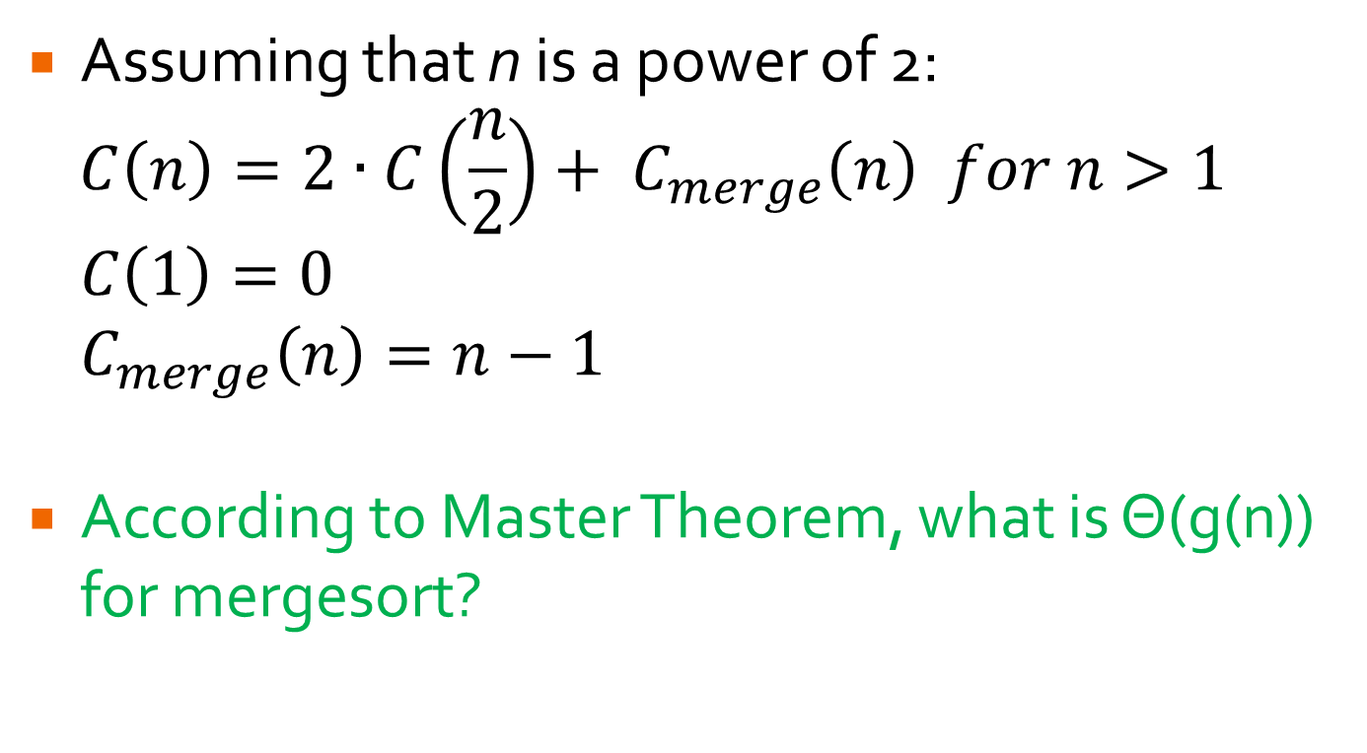
Efficiency of Mergesort
Assuming that n is a power of 2:
$$C\left(n\right)=2∙C\left(\frac{n}{2}\right)+ C_{merge}\left(n\right) for n>1$$
$C\left(1\right)=0$
$C_{merge}\left(n\right)=n−1$
According to Master Theorem, what is Θ(g(n)) for mergesort?

Slide 12
Properties of Mergesort
Stable
Requires linear amount of extra space
Variation: multiway mergesort divides into more than 2 sub-arrays.
Often used in file sorting.

Slide 13
Who remembers Lomuto Partitioning??
LomutoPartition(A[l…r])
p ← A[l]
s ← l
for i ← l + 1 to r do
if A[i] < p
s ← s + 1
swap(A[s], A[i])
swap(A[l], A[s])
return s
Partition the following array:
5 | 3 | 1 | 9 | 8 | 2 | 4 | 7 | 5
l,s | i |  |  |  |  |  |  | r

Slide 14
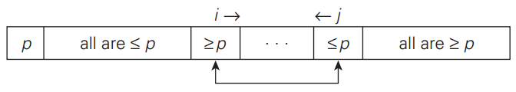
Hoare Partitioning
Scan from both ends at once:
i starts at index 1 and moves right until finds value ≥ p.
j starts at index n-1 and moves left until finds value ≤ p
Stopping when equal allows for more even split when array has many duplicates.

Slide 15
Hoare Partitioning
When scan stops, one of 3 situations exists:
i < j: we simply swap A[i] with A[j] and continue scanning.

Slide 16
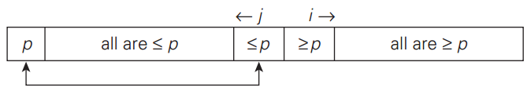
Hoare Partitioning
When scan stops, one of 3 situations exists:
i > j: since scanning indices have crossed, the array is partitioned and we simply need to swap pivot with A[j] to put pivot into correct position.

Slide 17

Hoare Partitioning
When scan stops, one of 3 situations exists:
i = j: must both be pointing to value that is same as pivot, so array is fully partitioned with no swaps.
Can merge with case 2 because swapping pivot with A[j] doesn’t change array at all.

Slide 18
Hoare Partitioning
HoarePartition(A[l…r])
p ← A[l]
i ← l; j ← r+1
repeat
repeat
i ← i+1
until A[i] ≥ p
repeat
j ← j-1
until A[j] ≤ p
swap(A[i],A[j])
until i ≥ j
swap(A[i], A[j]) // undo last swap when i ≥ j
swap(A[l], A[j])
return j

Slide 19
Hoare Partitioning
Partition the following array using Hoare Partitioning:
Your turn:
5 | 3 | 1 | 9 | 8 | 2 | 4 | 7
l |  |  |  |  |  |  | r
8 | 1 | 10 | 16 | 7 | 12 | 9 | 2 | 15
l |  |  |  |  |  |  |  | r

Slide 20
Quicksort
Recursively applies partitioning until array is fully sorted.
Quicksort(A[l…r])
if l < r
s ← Partition(A[l…r]) // s is split position
Quicksort(A[l…s-1])
Quicksort(A[s+1…r])

Slide 21
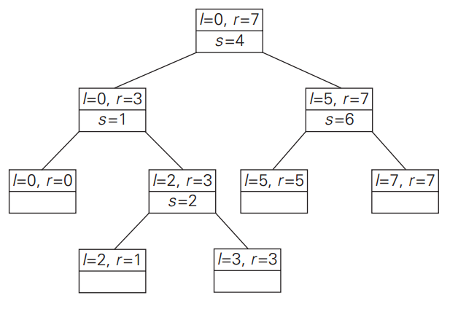
Quicksort

Slide 22
Properties of Quicksort
Best case: Θ(n log n)
Worst case: O(n²)
Avg case: ~1.39 n log₂n
Usually faster than Mergesort, can improve 30%:
Better pivot selection algorithms: e.g. median of three
3-way partition
Insertion sort for small subarrays (5-15 elements)
Requires logarithmic extra space
Not stable.

Slide 23
Geometric Problems

Slide 24
Quickhull Algorithm
Convex hull: smallest convex set that includes given points
Sort points by x-coordinate values
Identify extreme points P₁ and P₂ (leftmost and rightmost)
Splits points into 2 sets S₁ and S₂.
P₂
P₁

Slide 25
Quickhull Algorithm
Compute upper (and lower) hull recursively:
find point P_{max} that is farthest away from line P₁P₂
compute the upper hull of the points outside line P₁P_{max}
compute the upper hull of the points outside line P_{max}P₂
P_{max}
P₂
P₁
Discard points inside P₁ - P₂- P_{max} triangle.

Slide 26
Quickhull Algorithm
compute the upper hull of the points outside line P₁P_{max}
compute the upper hull of the points outside line P_{max}P₂ (no points in set)
P₂
P_{max}
P₁

Slide 27
Efficiency of Quickhull Algorithm
Sorting points in O(n log n) time
Finding point farthest away from line P₁P₂ can be done in linear time using determinant.
Overall Time efficiency:
worst case: Θ(n²) (as quicksort)
average case: Θ(n) (under reasonable assumptions about distribution of points given)

Slide 28
Closest Pair
Assume that your n points are sorted by x-coordinate in one list and by y-coordinate in second list.
If not already, can sort in Θ(n log₂n)
If 2 ≤ n ≤ 3, use brute force.

Slide 29
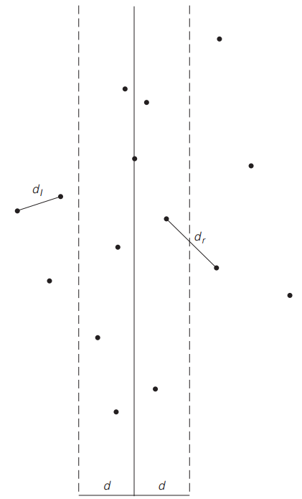
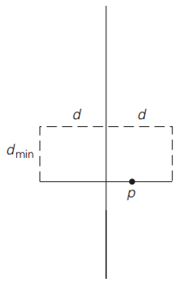
Closest Pair
If n > 3, draw line through median of x-values and divide points into 2 subsets, P_{L} & P_{R}
Apply recursively to P_{L} & P_{R}.
d = min(d_{L},d_{R})
Check pairs within distance d of median.

Slide 30
Closest Pair
d = min(d_{L},d_{R})
For points within distance d in x-direction of median…
…check adjacent pairs in y-sorted list within distance d of each other…
…update d if necessary
At most 6 such points

Slide 31
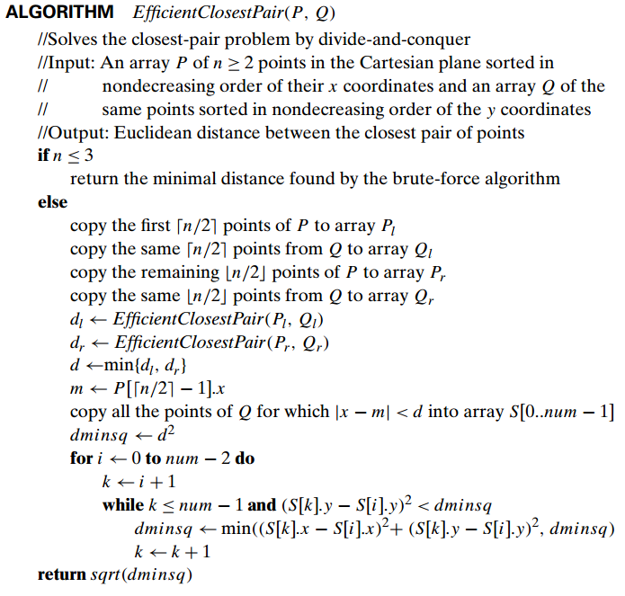

Slide 32
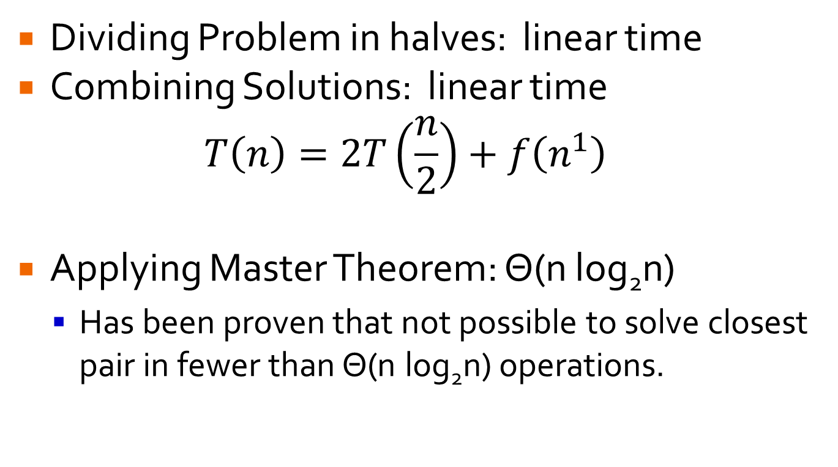
Divide-and-Conquer Closest Pair
Dividing Problem in halves: linear time
Combining Solutions: linear time
$$T\left(n\right)=2T\left(\frac{n}{2}\right)+f\left(n^{1}\right)$$
Applying Master Theorem: Θ(n log₂n)
Has been proven that not possible to solve closest pair in fewer than Θ(n log₂n) operations.

